Slide 1

Colgrow
Co L grow
NNECT.
EARN. .

Slide 2


Slide 3


Slide 4
Shyness?
Lack of Confidence?
Have a low Profile?
Why is that?
Tired?
Introvert?
Being lazy?
Unable to find people with same interests?

Slide 5



Slide 6
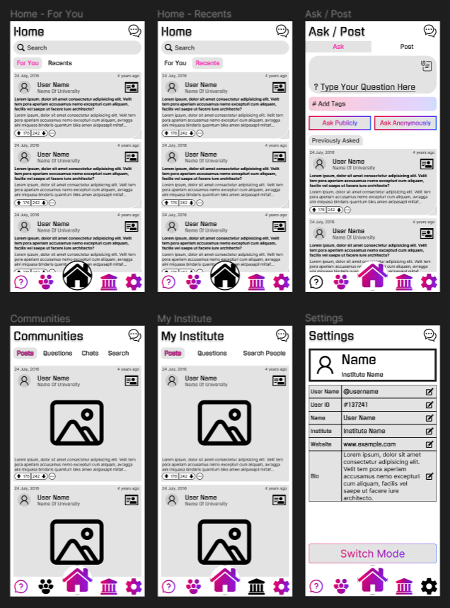
CONNECT.
LEARN.
GROW.
Colgrow

Slide 7
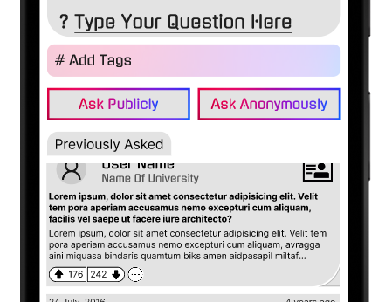
What’s wrong?
ASK TAB
ASK QUESTIONS
ANSWER QUESTIONS
POST CONTENT
Being shy?
Concerned about privacy?

Slide 8
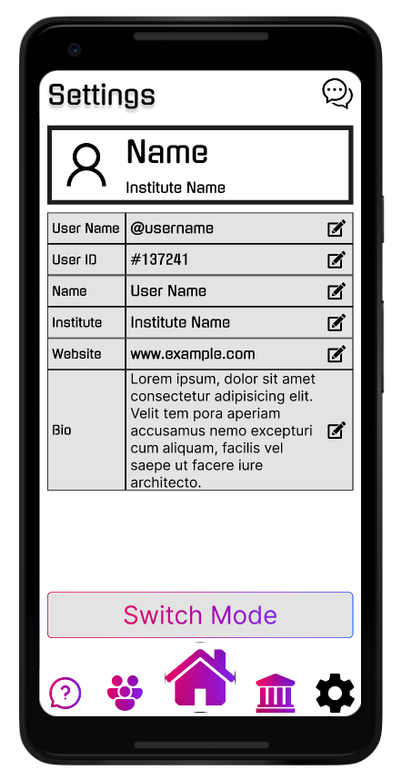

Slide 9
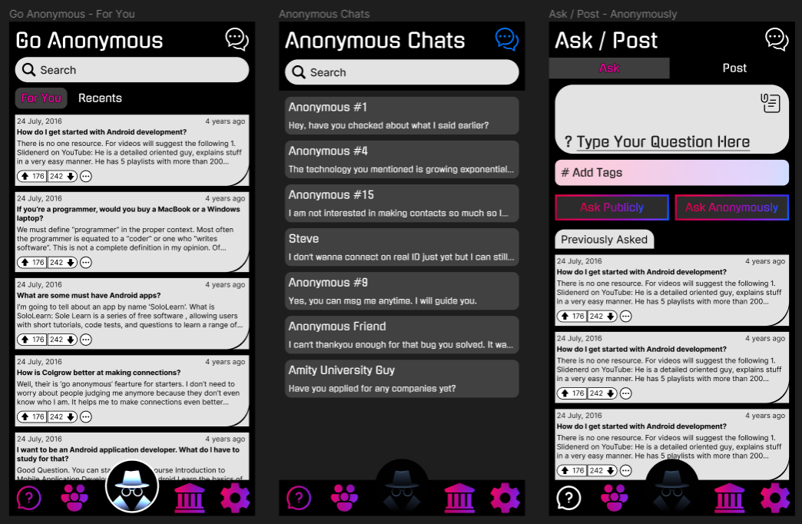

Slide 10
Colgrow
Co L grow
NNECT.
EARN. .

